Slide 1
Bazele inteligenței artificiale
Laborator – Grigore Ionuț

Slide 2


today’s lab

Slide 3
Content
Recurrent neural networks
Prepocessing steps for text in PyTorch
Gated recurrent units (GRU)
Long short-term memory (LSTM)
Sequence to sequence learning

Slide 4
1) Recurrent neural networks

Slide 5
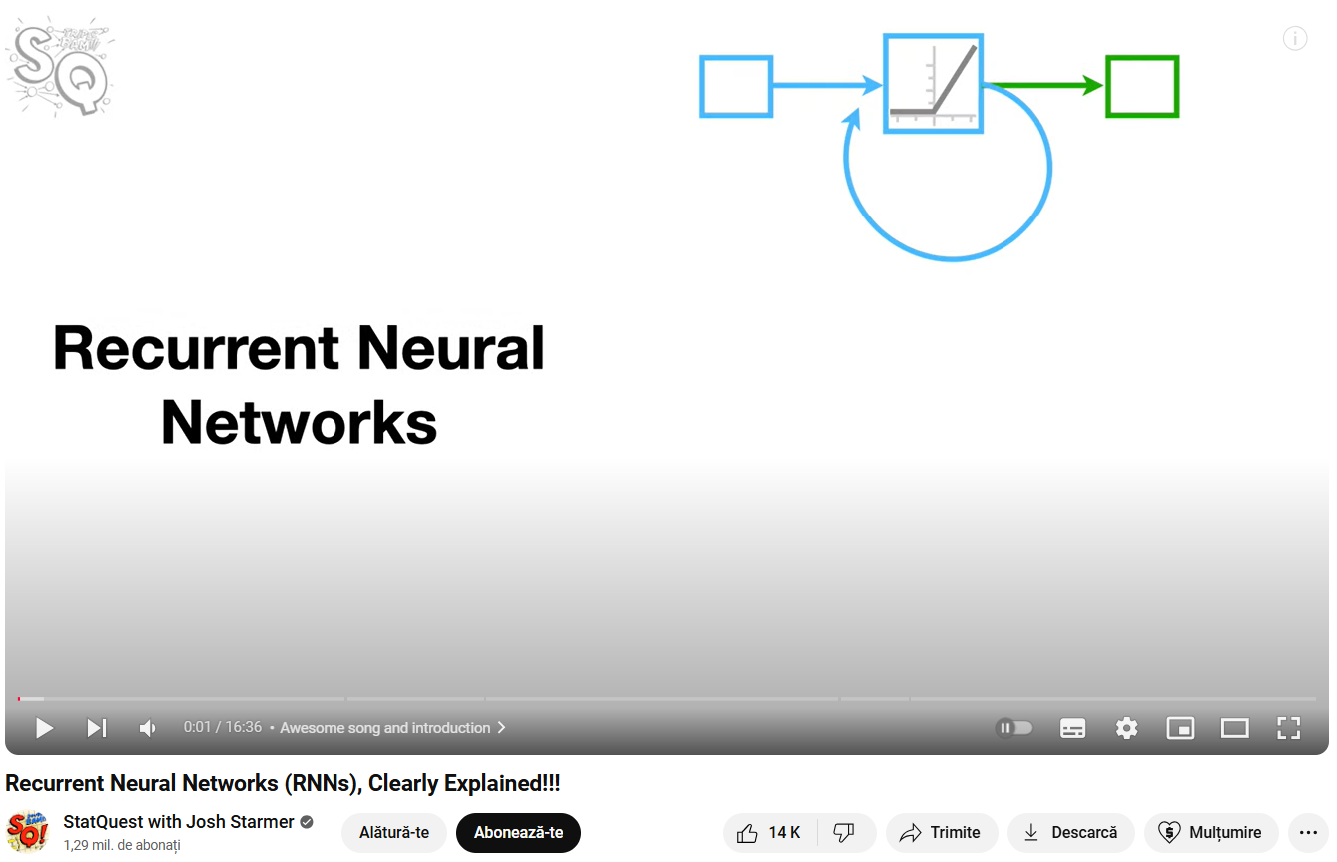
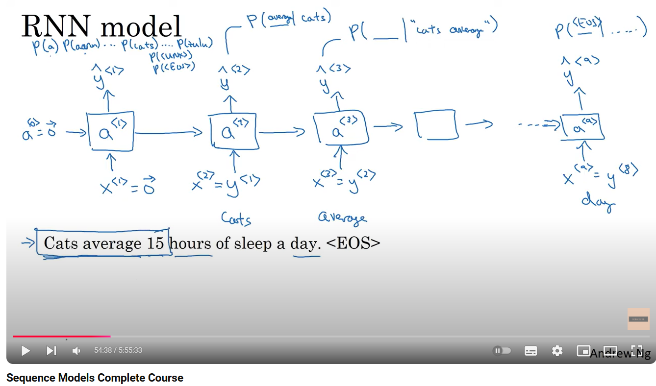

Slide 6


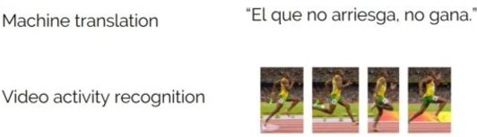



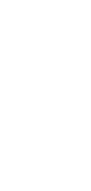
Recurrent neural networks (RNNs) are designed to work with sequential information (time series, speech, text, audio, video, etc.):
RNNs introduce state variables to store past information, together with the current inputs, to determine the current outputs:
RNN
RNN
RNN

Slide 7
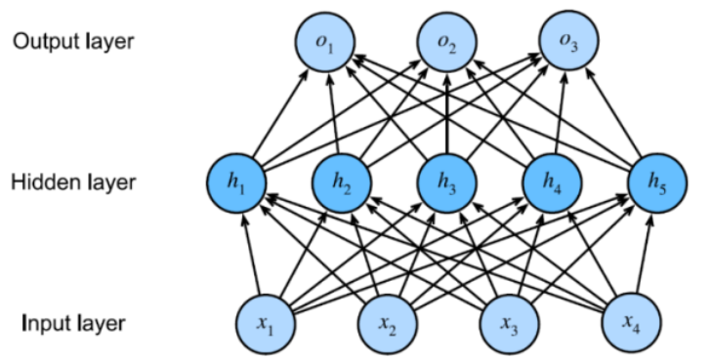








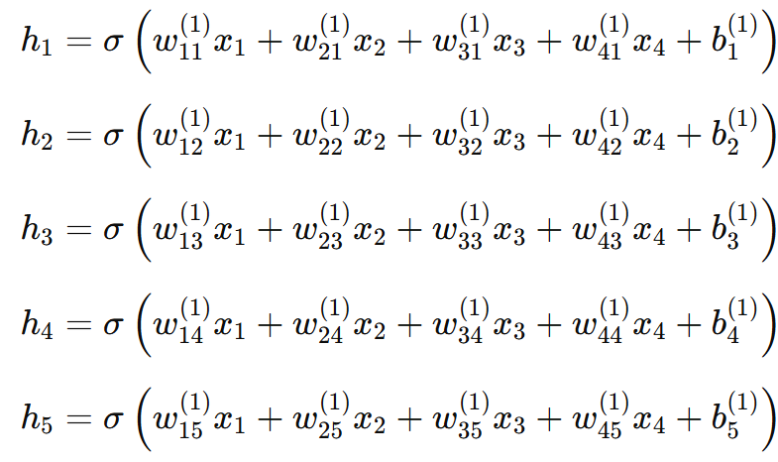
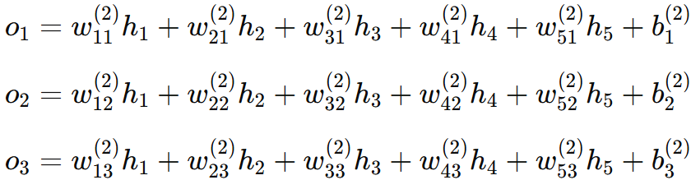


















































































Remember this example from lab 8 – a simple MLP
b⁽²⁾
b⁽¹⁾
We want to find these !

Slide 8


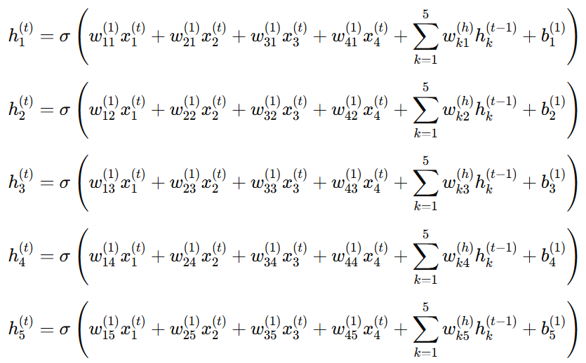
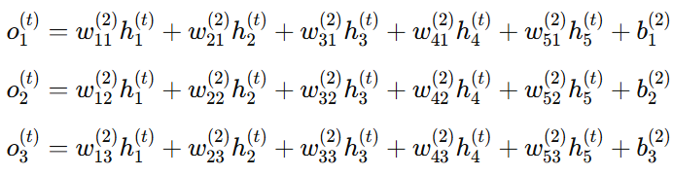







































































RNN – I know, a lot of math but is not so bad ☺
these are new
b⁽²⁾
b⁽¹⁾
this is new
We want to find these !

Slide 9
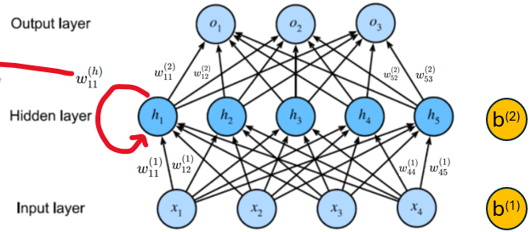

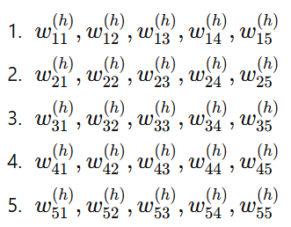









Unfolded form of an RNN
NOTE: we have 5 hidden units per hidden layer (h₁, h₂, h₃, h₄, h₅) ⇒ from one time step to other we will have 5x5 = 25 weights:
NOTE: here in this example I put just because otherwise it would make the diagram overly cluttered and harder to understand.
…and so on
time step 1
time step 2

Slide 10
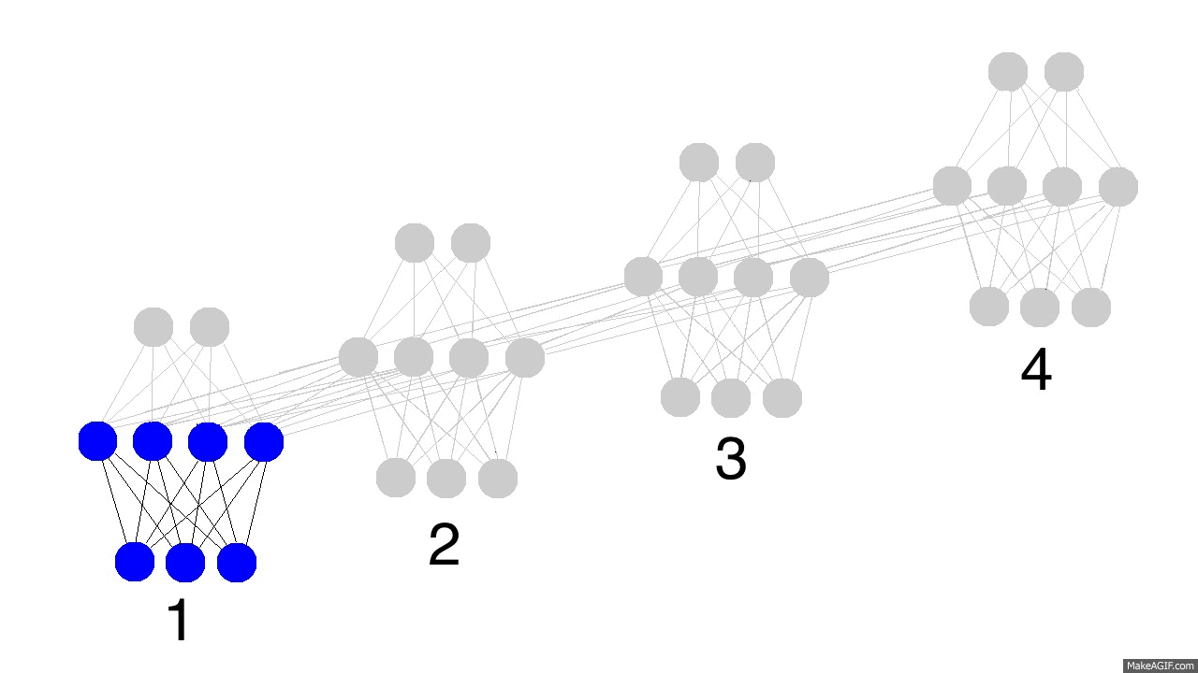
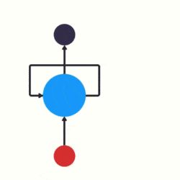
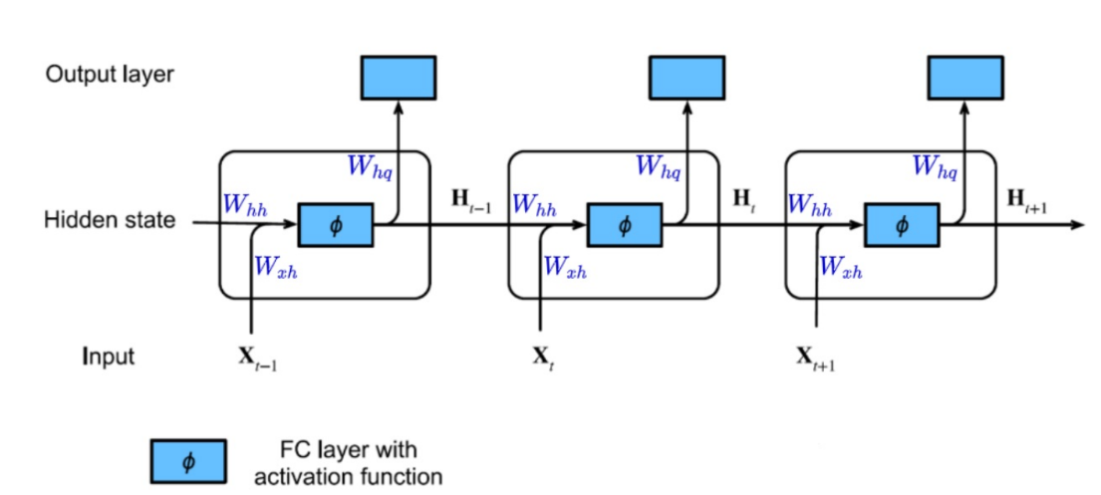
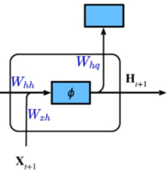




Unfolded form of an RNN
time step 4
time step 3
time step 2
time step 1
1
2
3
4
1
2
3
4

Slide 11
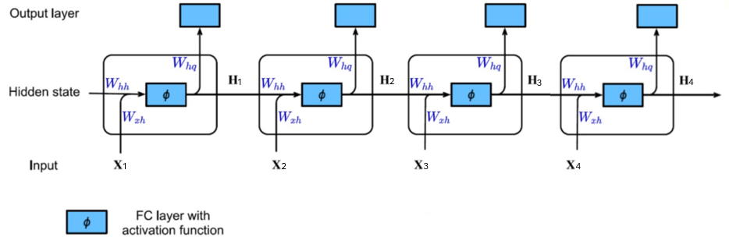
VERY IMPORTANT
in an RNN, the weights and biases used for computing the hidden state and output are the same at every timestep: input-to-hidden weights (𝑊_{xh} ), hidden-to-hidden (recurrent) weights (𝑊_{hh}​), hidden-to-output weights (𝑊_{hq} ) and biases (𝑏)
time step 4
time step 3
time step 2
time step 1

Slide 12
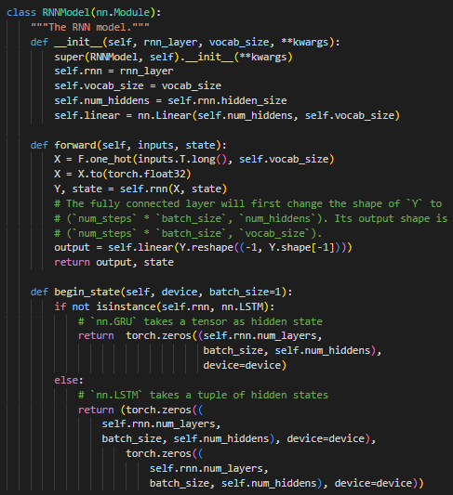


Slide 13
2) Prepocessing steps for text in PyTorch

Slide 14

Preprocessing steps for text:
  1) Load text as strings into memory
  2) Split strings into tokens (e.g. words and characters)
  3) Build a table of vocabulary/dictionary to map the split tokens to numerical indices (starting from 0)
  4) Convert text into sequences of numerical indices so they can be manipulated by RNNs easily

Slide 15
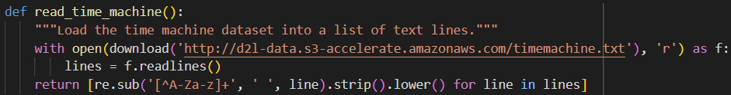
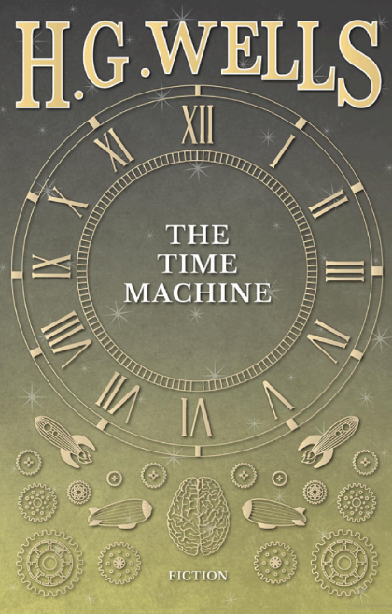
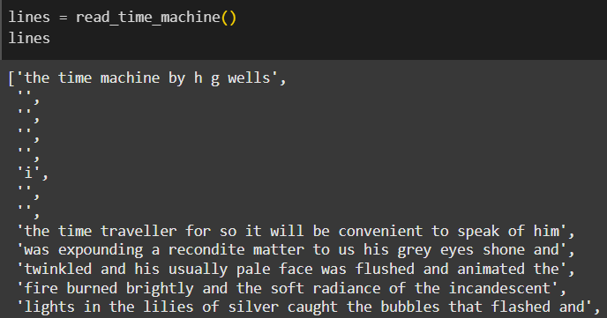

Load text as strings into memory
function from the lab, search it with CTRL + F ☺
read_time_machine() function reads the dataset into a list of text lines
timemachine.text contains the full text of The Time Machine, a classic science fiction novel by H.G. Wells
NOTE 1: each line is a string! (I know it’s weird to say that a line is a string but look at the example below ☺)
NOTE 2: - we removed non-alphabetical characters ([^A-Za-z]+) and replaces them with spaces
- we striped extra whitespace and converts all text to lowercase (.lower())
first line/string
second line/string
…and so on…

Slide 16
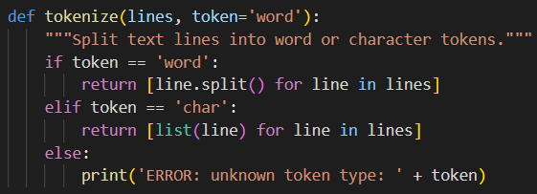
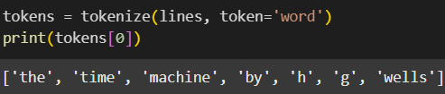
Split strings into tokens (e.g. words and characters)
tokenize() function takes a list (lines) as the input and splits each text line into a list of tokens
it supports tokenization at two levels: word and character. This is a common preprocessing step in natural language processing (NLP) tasks
word level:
character level:

Slide 17
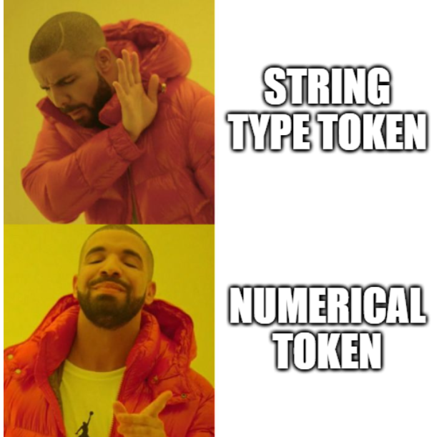
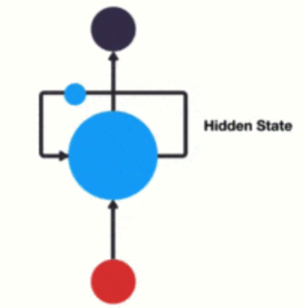

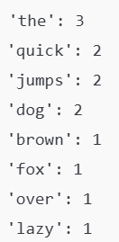
Build a table of vocabulary/dictionary to map the split tokens to numerical indices (starting from 0)
the string type of the token is inconvenient to be used by models which take numerical inputs
how we switch from string to numerical?
  a) count the unique tokens in the dataset (here dataset is often called corpus) and then
  assign a numerical index to each unique token according to its frequency
Example: suppose we have the following dataset:
we first calculate how many times each token appears in the dataset:

Slide 18
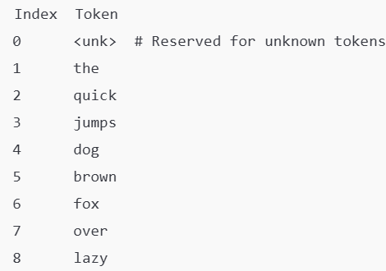


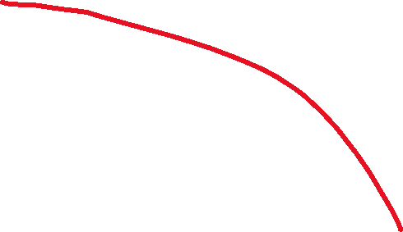

Build a table of vocabulary/dictionary to map the split tokens to numerical indices (starting from 0)
we assign numerical indices to the sorted tokens, starting from 0 for unknown (<unk>) and including reserved tokens if needed:
for example this one ☺
rarely appeared tokens are often removed to reduce the complexity
any token that does not exist in the dataset/corpus or has been removed is mapped into a special unknown token <unk>
Other reserved tokens: - <pad> - padding - is used to pad sequences so that all input sequences have the same length. This is necessary because ML models often require inputs of fixed size for batch processing:

Slide 19

Build a table of vocabulary/dictionary to map the split tokens to numerical indices (starting from 0)
        - <bos> - beginning of a sequence – it’s used to mark the start of a sequence, indicating where the input begins:
        - <eos> - end of a sequence - it marks the end of a sequence, signaling the model to stop processing or generating further tokens:
Let’s explain now step by step the Vocab class (see next slide)

Slide 20
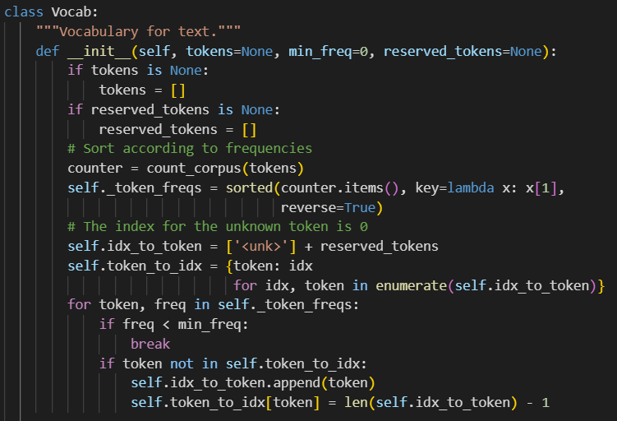
Build a table of vocabulary/dictionary to map the split tokens to numerical indices (starting from 0)
tokens:
  a list (or list of lists) of tokens, such as words or characters. These tokens will be used to build the vocabulary.
  default: None (empty vocabulary)
min_freq:
  minimum frequency threshold for tokens to be included in the vocabulary
  default: 0 (include all tokens, regardless of frequency)
reserved_tokens:
  a list of tokens that are always included in the vocabulary, such as <pad>, <bos>, <eos>
  default: None (no reserved tokens)

Slide 21
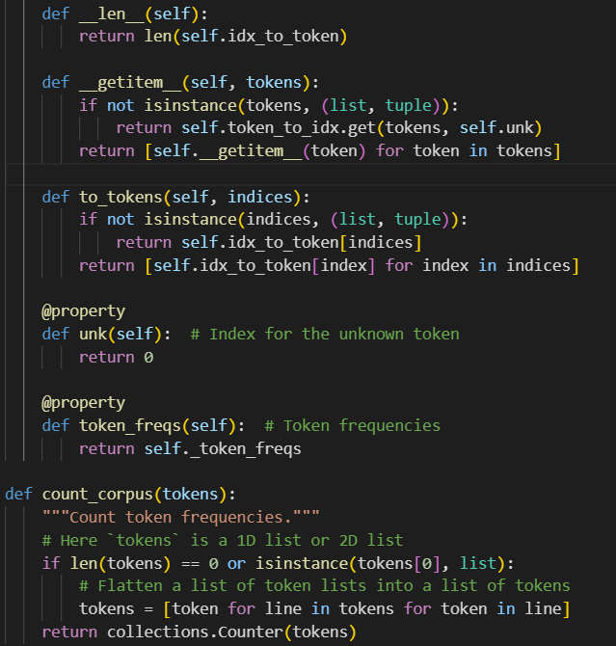
Build a table of vocabulary/dictionary to map the split tokens to numerical indices (starting from 0)
returns the size of the vocabulary (i.e., the total number of tokens)
converts tokens (or a list/tuple of tokens) into their corresponding indices
if a token is not found in the vocabulary, it returns the index of <unk>
converts indices (or a list/tuple of indices) into their corresponding tokens
returns the index of the unknown token (<unk>), which is always 0
returns the list of token-frequency pairs sorted by frequency in descending order
counts the frequency of tokens in the input, which can be either:
  a 1D list of tokens (e.g., ['time', 'machine', 'time’])
  a 2D list of token lists (e.g., [['time', 'machine'], ['time']])

Slide 22
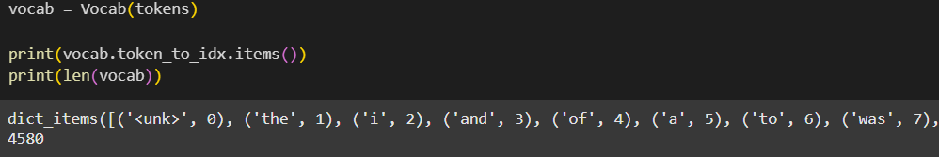

Build a table of vocabulary/dictionary to map the split tokens to numerical indices (starting from 0)
…and so on…

Slide 23

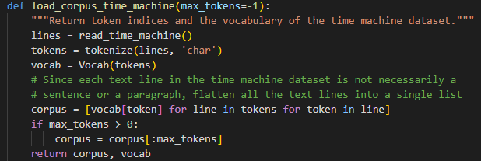
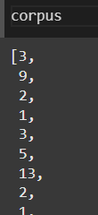

Convert text into sequences of numerical indices so they can be manipulated by RNNs easily
combine previous 3 steps
flattens all the tokenized lines into a single list of tokens
converts each token into its corresponding index using the vocabulary (vocab)
optionally truncates the resulting list to a maximum number of tokens, specified by max_tokens
this is the dataset we will train our RNN with !

Slide 24
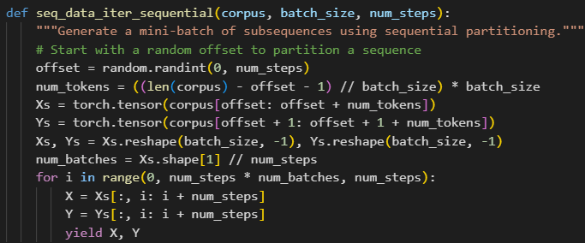
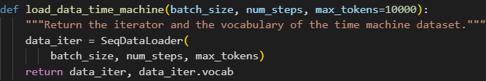
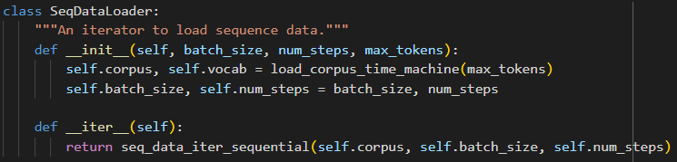

Just a few additional functions and we are ready
these are specified in the problem
this will be the input for the RNN !

Slide 25
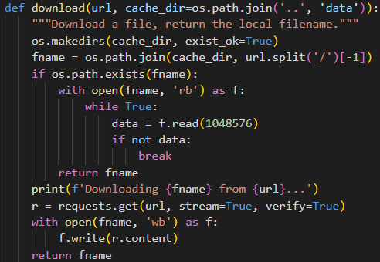
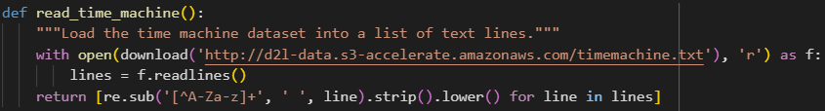
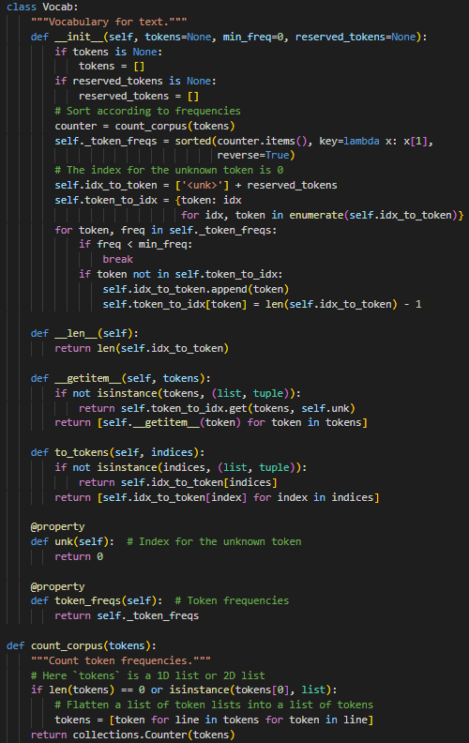
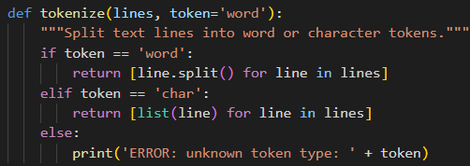
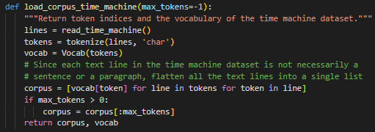
Recap

Slide 26
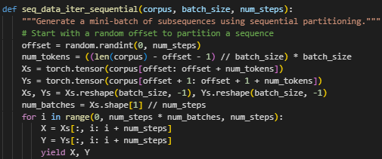
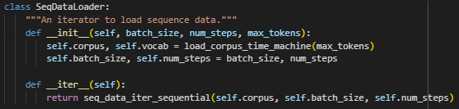




Recap
these are specified in the problem
all the work for this ☺

Slide 27
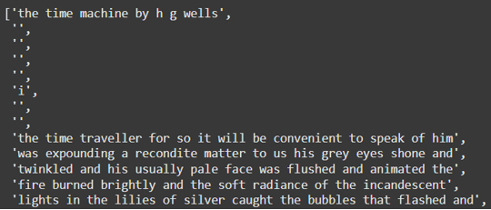




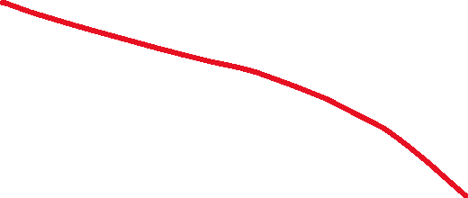

download the dataset:
tokenize each line at char or word-level:
build a table of vocabulary/dictionary (see slide 17):
[('<unk>', 0), (' ', 1), ('e', 2), ('t', 3), ('a', 4), ('i', 5), ('n', 6), ('o', 7), ('s', 8), ('h', 9), ('r', 10), ('d', 11), ('l', 12), ('m', 13), ('u', 14), ('c', 15), ('f', 16), ('w', 17), ('g', 18), ('y', 19), ('p', 20), ('b', 21), ('v', 22), ('k', 23), ('x', 24), ('z', 25), ('j', 26), ('q', 27)]
map each token to its numerical index and create a single list with indices for the dataset:
char-level
[('<unk>', 0), ('the', 1), ('i', 2), ('and', 3), ('of', 4), ('a', 5), ('to', 6), ('was', 7), ('in', 8), ('that', 9), ('my', 10), etc. ]
word-level
char-level
word-level

Slide 28

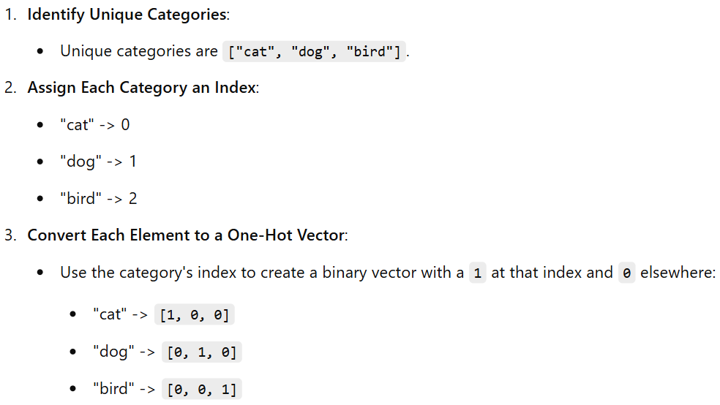
we need one more step, just one ☺
Simple one-hot encoding example:
list = ["cat", "dog", "bird", "dog", "cat"]
we take the list with the dataset:
we need to do
one-hot encoding!

Slide 29
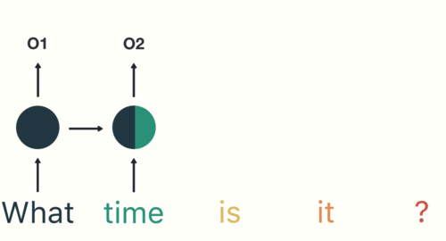
Application: text generation

Slide 30
3) Gated recurrent units (GRU)

Slide 31
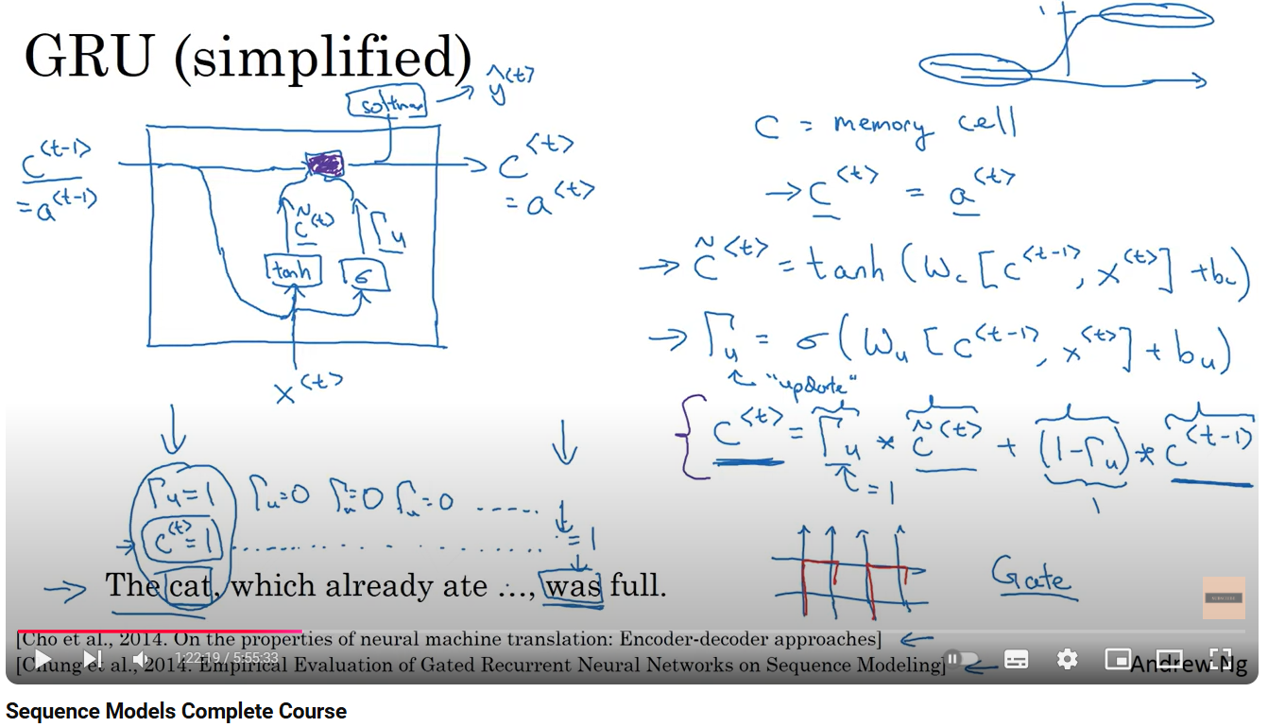

Slide 32
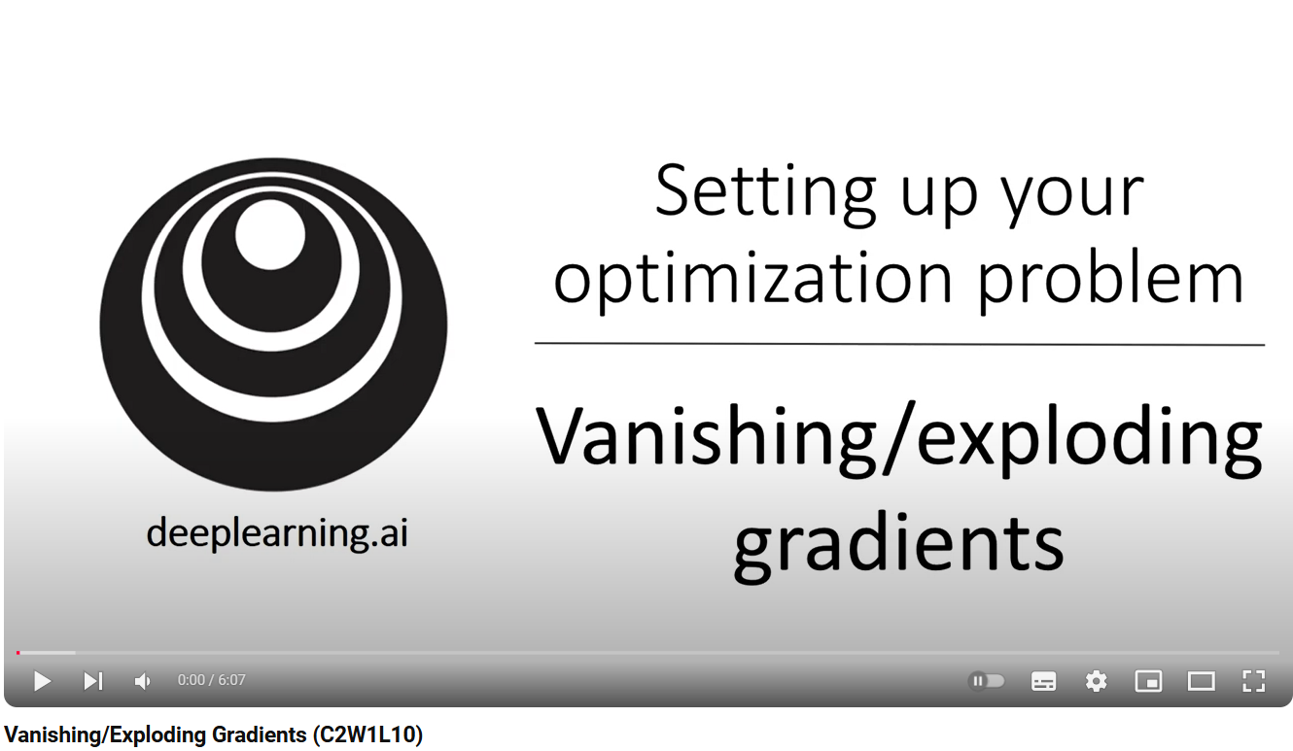

RNNs may suffer from the gradients issues (vanishing/exploding gradients):
to solve this problems, we have GRU (Gated Recurrent Units) and LSTM (Long Short-Term Memory)
GRU = RNN + reset gate + update gate
the reset gate determines how much of the previous hidden state (ℎ_{𝑡−1}) should be forgotten or ignored when computing the new hidden state
the update gate controls how much of the new hidden state and the previous hidden state (ℎ_{𝑡−1}) should be combined to form the current hidden state (ℎ_{𝑡})

Slide 33
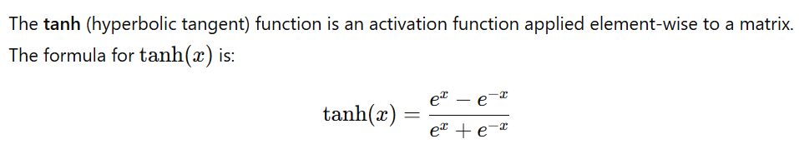
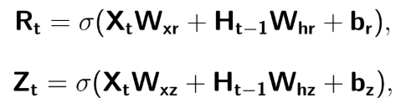




the Hadamard product (also known as the element-wise product) between 2 matrices is computed by multiplying corresponding elements of the 2 matrices:
GRU = RNN + reset gate + update gate

Slide 34

NOTE: comparing with a RNN layer, now for a GRU layer we will have the following learnable parameters: W_{xr} , W_{hr} , W_{xz} , W_{hz} , W_{xh} , W_{hh} , b_{r} , b_{z} , b_{h}

Slide 35






















RNN
GRU

Slide 36
4) Long short-term memory (LSTM)

Slide 37



Slide 38






the Hadamard product (also known as the element-wise product) between 2 matrices is computed by multiplying corresponding elements of the 2 matrices:
LSTM = RNN + output gate + input gate + forget gate + cell state

Slide 39




























RNN
GRU
LSTM

Slide 40
5) Sequence to sequence learning

Slide 41







(fixed length)
“Cum vi se pare laboratorul de BIA?”
(variable length)
“How do you like the BIA lab?”
(variable length)
RNNs
Applications:

Slide 42

Dataset
English-French dataset (we want to translate from English to French)
+ other more functions to process the dataset….

Slide 43




Model
2 RNNs: one for encoder and one for decoder:

Slide 44






these are specified in the problem
this is the model used for training ☺
we need to use 5 classes to obtain it

Slide 45
Exercises

Slide 46


Slide 47




Solutions

Slide 48




load and prepare the data:
JUST COPY PASTE FROM THE LAB FOR THESE FUNCTIONS!

Slide 49


JUST COPY PASTE FROM THE LAB FOR THESE FUNCTIONS!

Slide 50

JUST COPY PASTE FROM THE LAB FOR THESE FUNCTIONS!
This is our training data! We had 3 slides of copy-paste to obtain these!

Slide 51



define the RNN we will use:
JUST COPY PASTE FROM THE LAB FOR THESE FUNCTIONS!

Slide 52



write the functions for training:
JUST COPY PASTE FROM THE LAB FOR THESE FUNCTIONS!
I changed only these ☺

Slide 53



train the model:
plot the perplexities obtained during training:
print the perplexity of the model at the last epoch:

Slide 54

load and prepare the data:
JUST COPY PASTE FROM THE LAB FOR THESE FUNCTIONS!

Slide 55
JUST COPY PASTE FROM THE LAB FOR THESE FUNCTIONS!

Slide 56
JUST COPY PASTE FROM THE LAB FOR THESE FUNCTIONS!
This is our training data! We had 3 slides of copy-paste to obtain these!

Slide 57


define the GRU we will use:
JUST COPY PASTE FROM THE LAB FOR THESE FUNCTIONS!

Slide 58


write the functions for training:
JUST COPY PASTE FROM THE LAB FOR THESE FUNCTIONS!
I changed only these ☺

Slide 59



train the model:
plot the perplexities obtained during training:
print the perplexity of the model at the last epoch:

Slide 60
Thank you !

